Slide 1



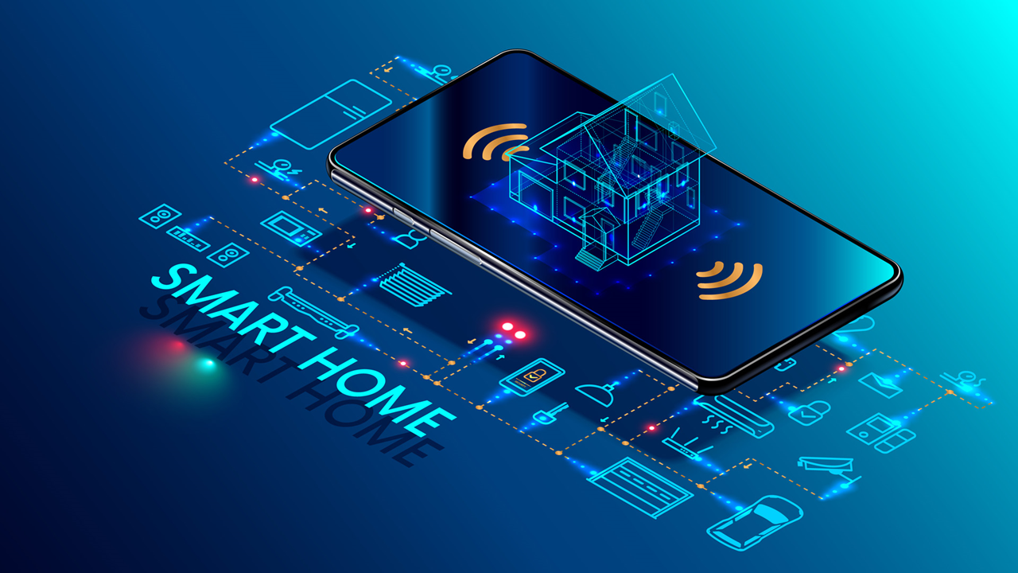
INTENSITY CONTROL OF HOME APPLIANCES USING MQTT PROTOCOL
Project ID - W27
6 CREDITS

Slide 2





TEAM COMPOSITION
ROHAN N KALPAVRUKSHA | PES1201802830
AKHIL V NAYANEGALI | PES1201801945
ROSHAN N KALPAVRUKSHA | PES1201802834
MRIDHULA SRIHARSHA | PES1201801122
GUIDE - Dr. Anuradha M
Professor and Chairperson, ECE Department

Slide 3
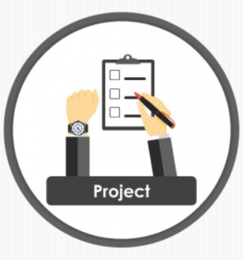
CONTENTS
Problem Statement
Motivation
Literature Review
Methodology
Block Diagram
Working Principle
Deliverables
Conclusion
Project timeline
References

Slide 4
PROBLEM STATEMENT
Brain-numbing task to walk out from our place to control various electric devices.
Relatively affordable, simple to implement and users friendly.
Develop a wrist band to control devices for visually/physically impaired people .

Slide 5
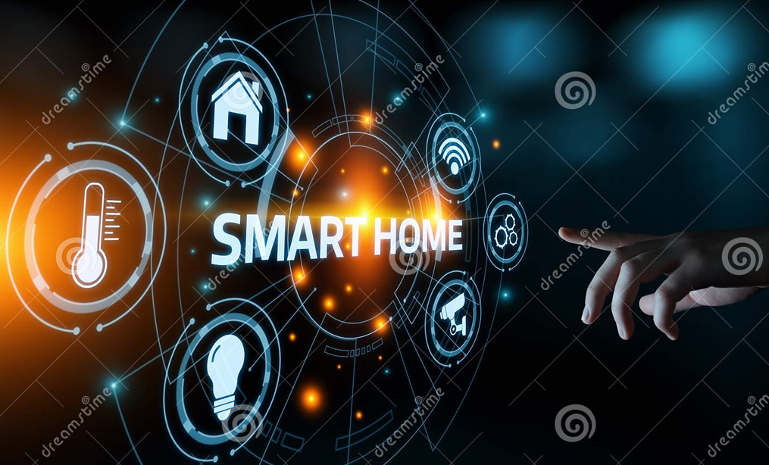
MOTIVATION
Smart homes are in demand
Self-regulating for physically
handicapped and old aged people
Visually impaired people find remote
controls hard to recognize.
One device to help various
special challenged people.

Slide 6
LITERATURE REVIEW
[1] J. S. Kalsi and J. Singh Ubhi, "A study of Conventional Protocols applicable to the emerging IoT Systems and Devices," 2019 International Conference on Automation, Computational and Technology Management (ICACTM), 2019, pp. 395-399, doi: 10.1109/ICACTM.2019.8776826
The paper gives a comparison of three important parameters i.e. operating frequency, range of trans-reception and data transmission rate. The study also provides a bird eye view for selection of appropriate protocol as per the required application.

Slide 7
LITERATURE REVIEW
[2] M. O. Al Enany, H. M. Harb and G. Attiya, "A Comparative analysis of MQTT and IoT application protocols," 2021 International Conference on Electronic Engineering (ICEEM), 2021, pp. 1-6, doi: 10.1109/ICEEM52022.2021.9480384
MQTT is an important lightweight of IoT application layer protocols. MQTT was more suitable in high traffic and high volume messages than COAP protocol. Besides, it has the advantage of ordered messages receiving over AMQP and COAP protocols.

Slide 8
LITERATURE REVIEW
[3] Indu Dokare, Raghav Potdar, Rahul Sohandani, Soham Phutane, Alish Wadhwani, ‘Voice Controlled Smart Home’, International Journal of Future Generation Communication and Networking, Vol. 13, No. 1s, (2020), pp. 368—376, ISSN: 2233-7857 IJFGCN
This proposed a methodology to make use of Google Assistant to Communicate through various devices using Open Hab Connector and using MQTT protocol for communication. This paper gives a bird eye of the efficiency of Google Assistant working with MQTT protocol

Slide 9
LITERATURE REVIEW
[4] Atmoko, Rachmad & Riantini, R & Hasin, M, “IoT real time data acquisition using MQTT protocol”, 2017 Journal of Physics: Conference Series. 853. 012003. 10.1088/1742-6596/853/1/012003
According to the results of the test, the MQTT protocol is capable of transferring data six times faster than the HTTP standard. MQTT usage can be an option for the hardware data acquisition real-time application based on the Internet of Things.

Slide 10
LITERATURE REVIEW
[5] K. Loga Priya1, Mrs. S. Saranya2,” Voice-Activated Home Automation using NodeMCU”, International Research Journal of Engineering and Technology (IRJET), Volume: 07 Issue: 02 | Feb 2020
The result of this paper provides the smart home automation system using voice commands.
The Google Assistant is takes in the voice commands . Google assistant can be easily incorporated to the Home Automation Applications

Slide 11
LITERATURE REVIEW
[6] N. Nikolov, "Research of MQTT, CoAP, HTTP and XMPP IoT Communication protocols for Embedded Systems," 2020 XXIX International Scientific Conference Electronics (ET), 2020, pp. 1-4, doi: 10.1109/ET50336.2020.9238208
There exists many IOT protocols for different application and purpose. The engineers should have deep knowledge on each protocols to decide the most appropriate one for their applications. MQTT and CoAP protocol are the most suitable for IoT message based application.

Slide 12
METHODOLOGY
“Not just ON and OFF, but also vary intensity at VARIOUS LEVELS”
Touch Based Sliding Bar
Slide movement in
UBIDOTS server
Voice Commands
Input such as Intensity 200, Intensity 250….
Gesture Based
Various angles of hand movements
Wi-Fi – IoT – MQTT Protocol

Slide 13
BLOCK DIAGRAM
USER/CONTROLLER
DEVICES CONTROLLED
Node MCU
Publisher
MQTT Broker
Publish
Subscribe
Node MCU
Subscriber
WRIST
BAND
WI-FI
Accelerometer
Senses Gesture
LIGHT
FAN
ANDROID
MOBILE
Google
Assistant
Slide Bar
Senses Voice
Senses Movement

Slide 14
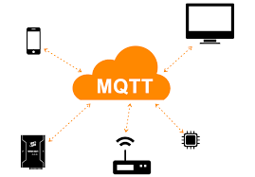
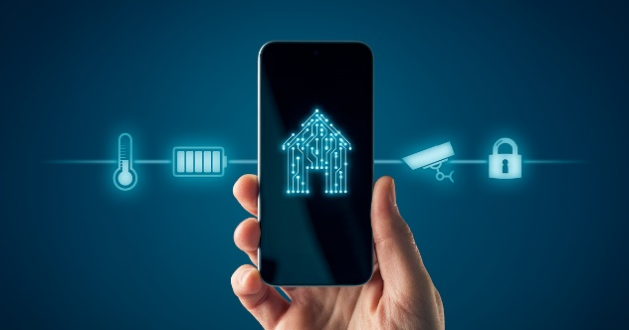

WORKING PRINCIPLE
The proposed model uses MQTT protocol for Communication.
The Leading Edge phase dimming Circuit is the Subscriber
The wristband and the Google Assistant are the Publisher

Slide 15
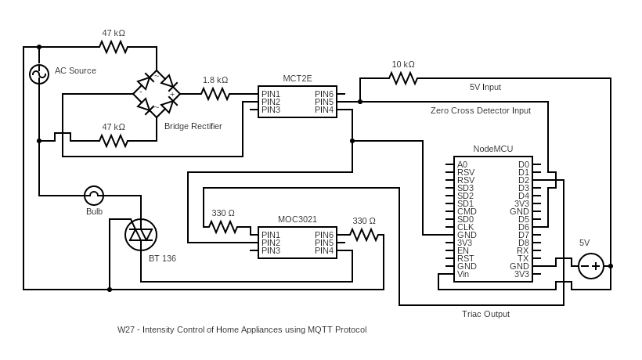
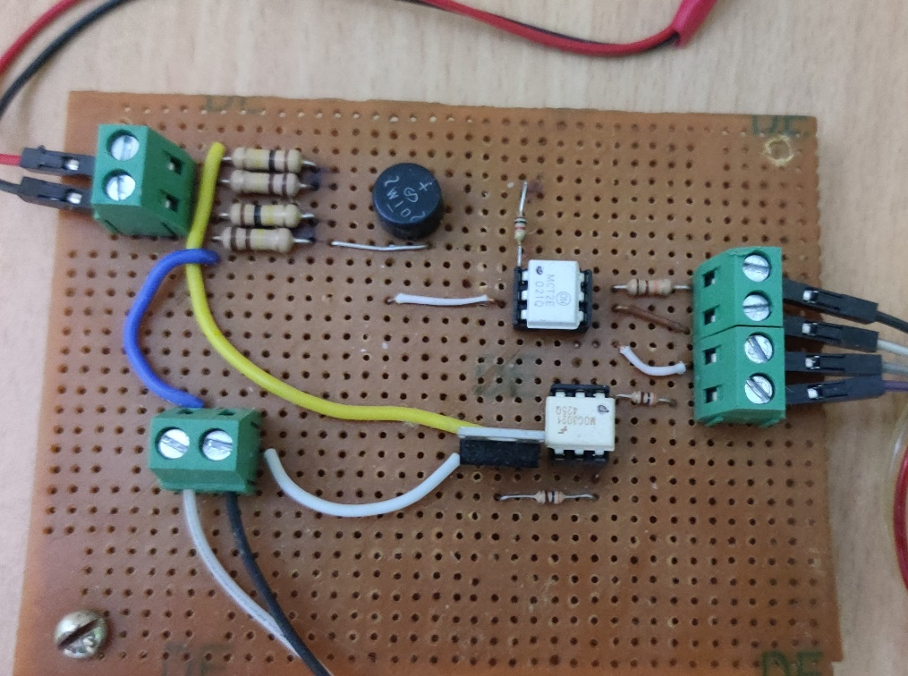
WORKING PRINCIPLE
Image of the Subscriber Circuit
Schematic of the Subscriber Circuit

Slide 16
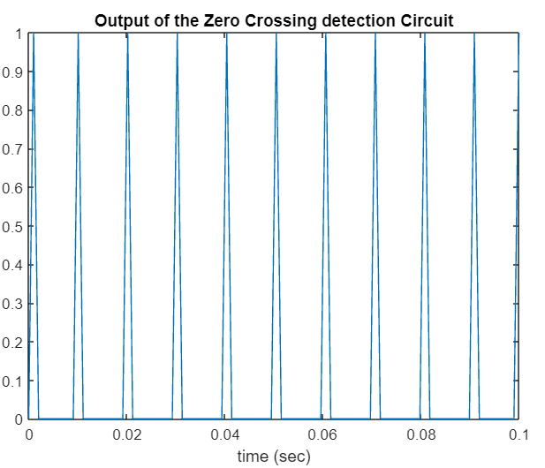
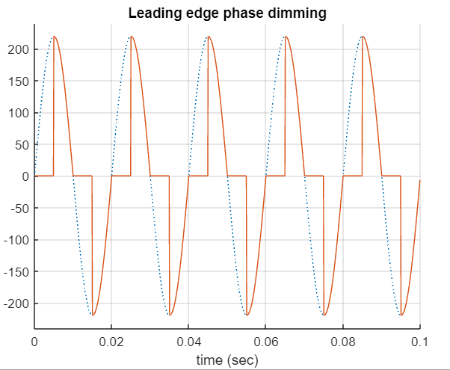
WORKING PRINCIPLE

Slide 17


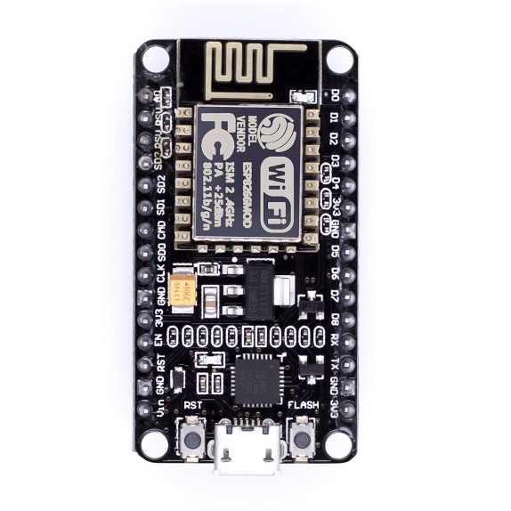
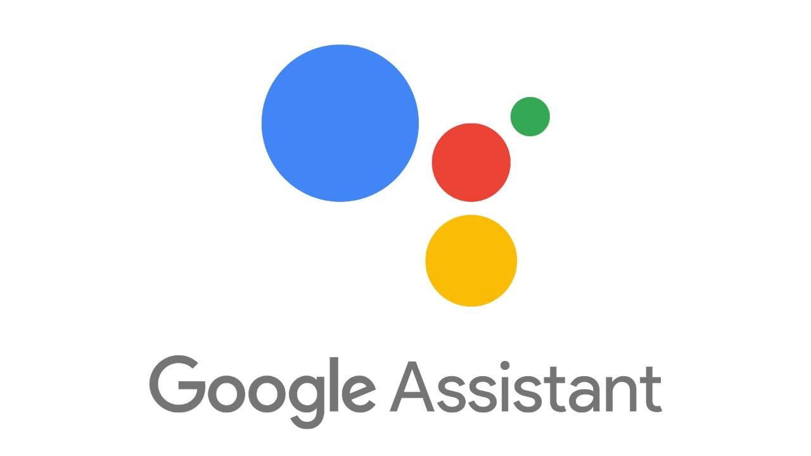

WORKING PRINCIPLE
Hey Google, Turn on Bulb at 30 %

Slide 18
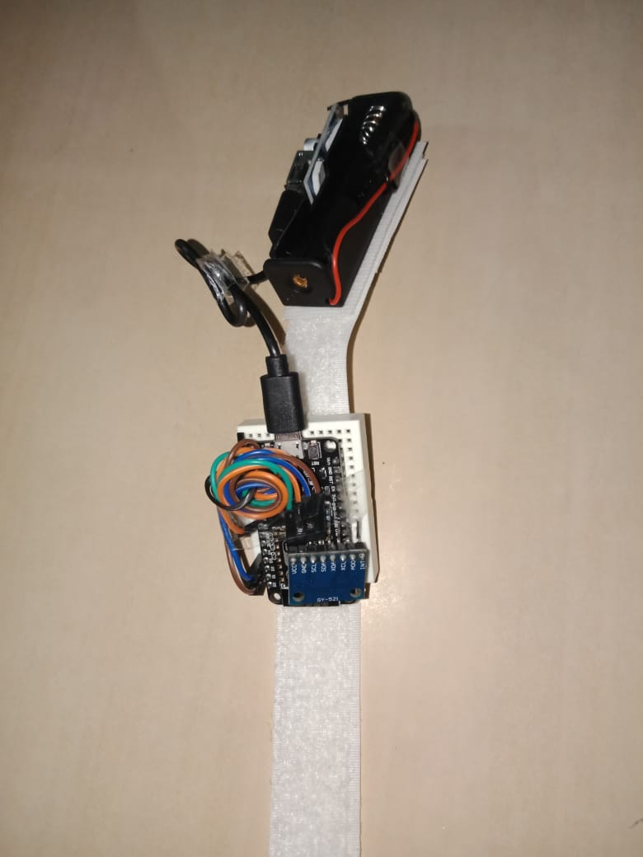
DELIVERABLES
An Innovative way to control the Home appliance.
A slide bar that controls the intensity of fan and bulb based on levels on the slide bar
Wristband that can take gestures as input and control the intensity of light and fan
Voice Control through Google Assistant which takes voice as input and can control the light and fan
Technical Paper writing

Slide 19
CONCLUSION
This project proposes an innovative way to control Home Appliance
Gesture-based interaction has demonstrated to have a future of interaction between people and electrical appliances as a technological improvement.
The main advantage of the proposed method is scalability.
It’s a low-cost Solution
As a result of this approach , there is power saving .
Future Scope, implementing this method into smart watch and to fail-safe system for this approach.

Slide 20
PROJECT TIMELINE
SCHEDULE | JAN | FEB | MAR | APR | MAY | JUN | JUL | AUG | SEP
DECISION & LITERATURE SURVEY
FINALISATION OF METHODOLOGY
IMPLEMENTATION – SLIDE BAR
IMPLEMENTATION – GESTURE
IMPLEMENTATION – VOICE
EXTENSION TO FAN AND DESIGN OF THE WRISTBAND

Slide 21
REFERENCES
[1] J. S. Kalsi and J. Singh Ubhi, "A study of Conventional Protocols applicable to the emerging IoT Systems and Devices," 2019 International Conference on Automation, Computational and Technology Management (ICACTM), 2019, pp. 395-399, doi: 10.1109/ICACTM.2019.8776826
[2] M. O. Al Enany, H. M. Harb and G. Attiya, "A Comparative analysis of MQTT and IoT application protocols," 2021 International Conference on Electronic Engineering (ICEEM), 2021, pp. 1-6, doi: 10.1109/ICEEM52022.2021.9480384
[3] Atmoko, Rachmad & Riantini, R & Hasin, M, “IoT real time data acquisition using MQTT protocol”, 2017 Journal of Physics: Conference Series. 853. 012003. 10.1088/1742-6596/853/1/012003.
[4] K. Loga Priya1, Mrs. S. Saranya2,” Voice-Activated Home Automation using NodeMCU”, International Research Journal of Engineering and Technology (IRJET), Volume: 07 Issue: 02 | Feb 2020
[5] N. Nikolov, "Research of MQTT, CoAP, HTTP and XMPP IoT Communication protocols for Embedded Systems," 2020 XXIX International Scientific Conference Electronics (ET), 2020, pp. 1-4, doi: 10.1109/ET50336.2020.9238208
[6] Assad Mohammed , Amar Seeam, Xavier Bellekens z, Kamila Nieradzinska x, Visham Ramsurrun , “Gesture based IoT Light Control for Smart Clothing” , 2016 IEEE International Conference on Emerging Technologies and Innovative Business Practices for the Transformation of Societies (EmergiTech), Avaliable online:10.1109/EmergiTech.2016.7737326
[7] Sajid Nagarboudi Patel a, R.D.Salagarb ,”A Review on Iot Light Control for Smart Clothing using Gesture Control” International Journal of Innovative and Emerging Research in Engineering Volume 4, Issue 6, 2017.
[8] Yash Govilkar, Dr. Rupesh Jaiswal , “A Gesture Based Home Automation System” , International Journal for Research in Applied Science & Engineering Technology (IJRASET), Volume 7 Issue XI, Nov 2019, Available online: http://doi.org/10.22214/ijraset.2019.11081

Slide 22
REFERENCES
[10] Ravi Kishore Kodali, Borra Yatish Krishna Yogi, Gudibanda Nagesh Sharan Sai and Jehova Honey Domma,” Implementation of Home Automation Using CoAP” , Proceedings of TENCON 2018 - 2018 IEEE Region 10 Conference (Jeju, Korea, 28-31 October 2018)
[11] Kamelya Dehghani Kohnehshahri, Mohammad Hasan Kargar, Fatemeh Soleimani-Roozbahani,” The Effect of Using COAP Protocol on Reducing Energy Consumption in Smart Houses”, Int. J. Advanced Networking and Applications, Volume: 10, Issue: 03Pages: 3843-3852 (2018) ISSN: 0975-0290
[12] Mubashir Ali1, Zarsha Nazim, Waqar Azeem , Khadija Javed , Maria Tariq, Muhammad Haroon, Aamir Hussain, ‘An IoT based Approach for Efficient Home Automation with ThingSpeak’, International Journal of Advanced Computer Science and Applications, Vol. 11, No. 6, 2020
[13] Mr.Rohit Kadam ,Mr.Pranav Mahamuni ,Mr.Yash Parikh, ‘Smart Home System’, International Journal of Innovative Research in Advanced Engineering (IJIRAE) ISSN: 2349-2163 Volume 2 Issue 1, January 2015
[14] Shruthi.J1 , Ramya.S2 , Bharathi.R, ‘HOME APPLIANCE CONTROL FOR USERS WITH MOTOR DISABILITIES USING SMART PHONE’, International Journal of Innovative Research in Advanced Engineering (IJIRAE) ISSN: 2349-2163 Volume 1 Issue 6, July 2014
[15] Praful Nandankar, Akash Zade, Namrata Wadhai, ‘HOME AUTOMATION SYSTEM USING ANDROID MOBILE PHONE’, International Journal of Innovative Research in Advanced Engineering (IJIRAE) ISSN: 2349-2163 Issue 04, Volume 5, April 2018
[16] Sarika N. Gaikwad, Prof. M. S. Chaudhari, ‘Home Automation System Embedded In an Internet-Of-Things Platform’, International Journal of Advanced Research in Electrical, Electronics and Instrumentation Engineering, Vol. 7, Issue 7, July 2018, Website: www.ijareeie.com
[17] Shikhar Sharma1, Shripad S. Desai, ’ Home Automation System (HAS) using Android for Mobile Phone’, International Journal Of Innovative Research In Technology ISSN: 2349-6002, Volume 7 Issue 8 , January 2021
[18] Ms. Pooja Bhagat-Thakre, Vrushali Deshpande, Aishwarya Daundkar, Sanika Haval, Rohankumar Patel, ‘Accelerometer based data glove for blind and dumb’, International Journal of Creative Research Thoughts (IJCRT), ISSN: 2320-2882
[19] Jun Xu, Xiong Zhang and Meng Zhou, ‘A High-Security and Smart Interaction System Based on Hand Gesture Recognition for Internet of Things’, Hindawi Security and Communication Networks Volume 2018, Article ID 4879496, 11 pages, 6 June 2018, Website-https://doi.org/10.1155/2018/4879496
[20] Indu Dokare, Raghav Potdar, Rahul Sohandani, Soham Phutane, Alish Wadhwani, ‘Voice Controlled Smart Home’, International Journal of Future Generation Communication and Networking, Vol. 13, No. 1s, (2020), pp. 368—376, ISSN: 2233-7857 IJFGCN

Slide 23
SUBMISSIONS – W27
PROJECT REPORT - YES
PROJECT POSTER - YES
PROJECT VIDEO - YES
INDIVIDUAL CONTRIBUTION - YES
PROJECT DIARY - YES

Slide 24
THANK YOU !!!!!

